Slide 1
Records Management
University of Texas at Dallas
Office of Legal Affairs

Slide 2
What is Records Management?
A set of activities required to systematically control the creation, receipt, use, retention, preservation, and destruction of recorded information maintained as evidence of business activities and transactions
BENEFITS
Provides a consistent and logical framework to handle state/university records through policies and procedures
Supports business operations with processes for capturing and maintaining evidence of official university business activities and transactions
Helps reduce costs associated with information retrieval and storage
Preserves history and culture of UT Dallas

Slide 3
Legal Foundations
Texas Government Code 441.180 – 441.200
General state records management laws
Texas Administrative Code Title 13 Part 1 Chapter 6 Subchapter A
Regulations regarding electronic state records
Texas Government Code 552- Public Information Act
Laws regarding availability of government records to the public
State of Texas Records Retention Schedule
Retention schedule for records common to all state agencies
State of Texas University Records Retention Schedule
Retention schedule for records common to all state universities
Code of Federal Regulations
Contains retention requirements for records of federally regulated activities or funded programs
Federal and State law requires public institutions establish an active records management program to ensure that public records are
created, maintained, and available for public use
properly stored in public archives or destroyed

Slide 4
Roles and Responsibilities
TSLAC
Institution Head
Records Management Officer
Department Head
Department Records Manager
Texas State Library and Archives Commission
Statutory authority for State of Texas
Maintains State records retention schedules
Approves UTD’s Retention Schedule
Responsible for active and ongoing records management program
May delegate administration to RMO
TSLAC will only conduct official business with the President or RMO
Administers records management program at UTD
Implements controls for records retention and disposition
Provides training, resources, and tools to departments
Responsible for implementing RM program and policy in department
Designates at least one Department Records Manager
Administers records management for department or unit at direction of business owner
Manages records
Maintains tools
Requests to dispose of records
Interfaces with Legal Affairs

Slide 5
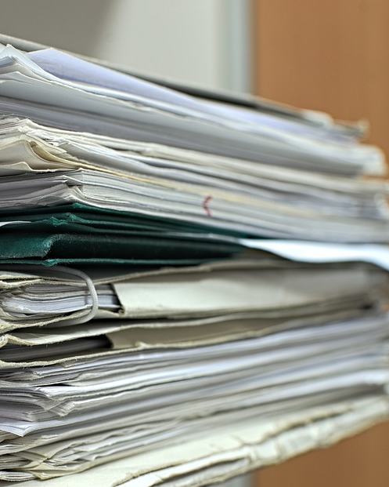
Identifying Record Types

Slide 6
What is a Record?
Any recorded information created or received in the course of conducting university business
University business includes all university activities and operations and interactions between the university and its internal and external constituents
University records include records stored anywhere and in any format: department, enterprise, or third-party services or storage

Slide 7
What is not a Record?
Non-records are identified by the state of Texas
Library or museum material made or acquired and maintained solely for reference or exhibition purposes
A stock of publications or blank forms*
Catalogs or trade journals
Unsolicited advertisements
* One copy of a university publication or form should be kept as the master record by the program that created it

Slide 8
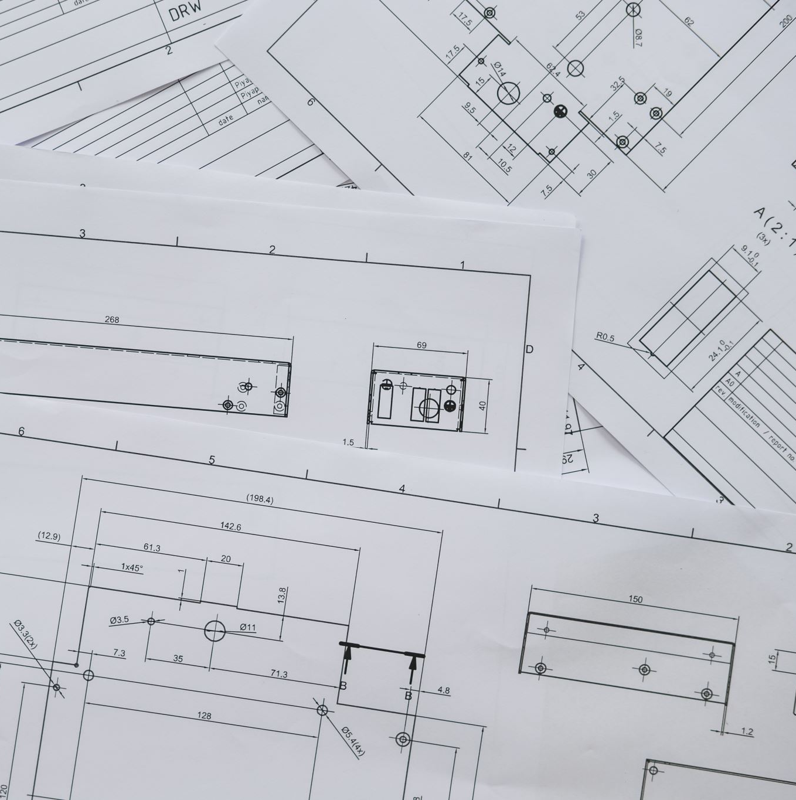
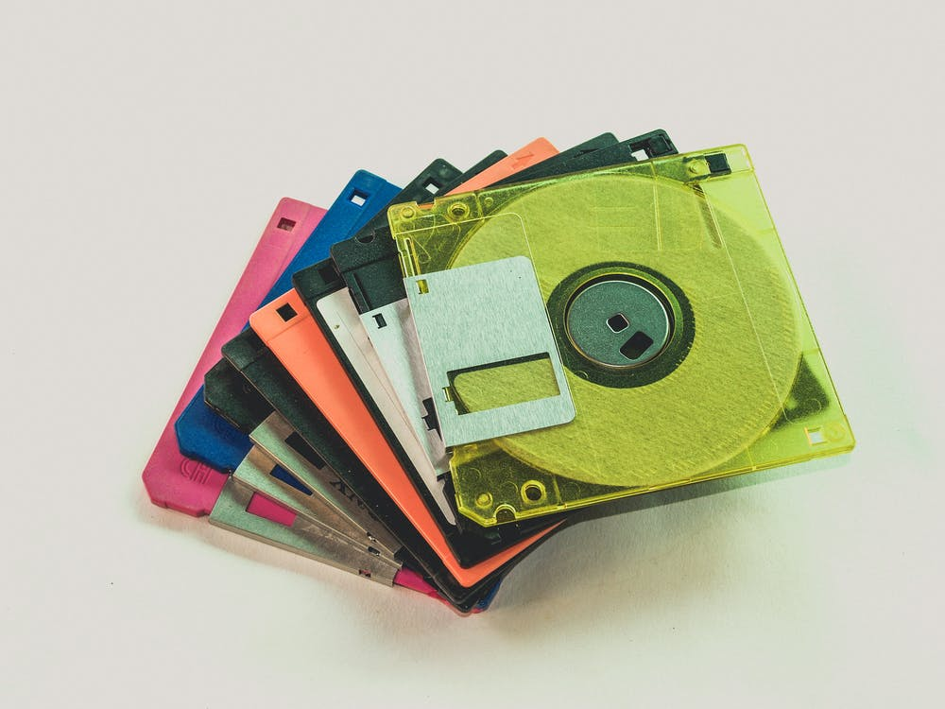
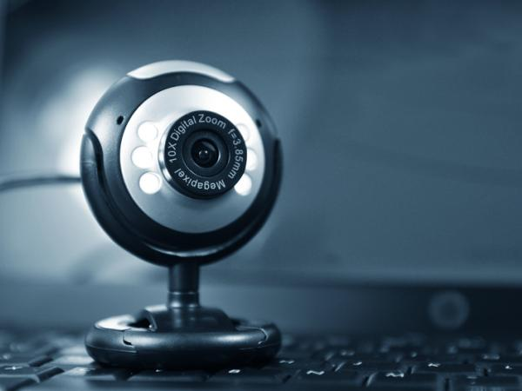
Record Formats
A record may be in any format, and the retention obligations do not change
Can be the original or a copy of the original document
Department must determine whether each record is a master record, a convenience copy, or transitory information

Slide 9
Record Types
Master
Record
(Record Copy)
Convenience Copy
Transitory Information
University must keep one copy of every record created or received through business processes
Retention rules apply to that copy, which is the master record
Cannot be destroyed without authorization from the RMO
Copies of master records that are created for convenience, reference, or research
Best practice to identify from start as copy
Does not require retention or request to dispose of records
Records of temporary usefulness that meet certain criteria
Retained only until they have served their purpose
Do not require a request to dispose of records

Slide 10
Transitory Information
Records of temporary usefulness that are not an integral part of a record series of an agency, that are not regularly filed with an agency's record-keeping system, and that are required only for a limited period time for the completion of an action by an official or employee of the agency or in the preparation of an ongoing record series.
are not essential to compliance with state law
do not document, support, or arise from university business processes
are transferred to a master record, e.g., notes transferred to a record
cannot be classified as an integral part of any record series of UTD RRS
Transitory records do not need approval from OLA to dispose of and should NOT be included on a Records Disposal Request

Slide 11
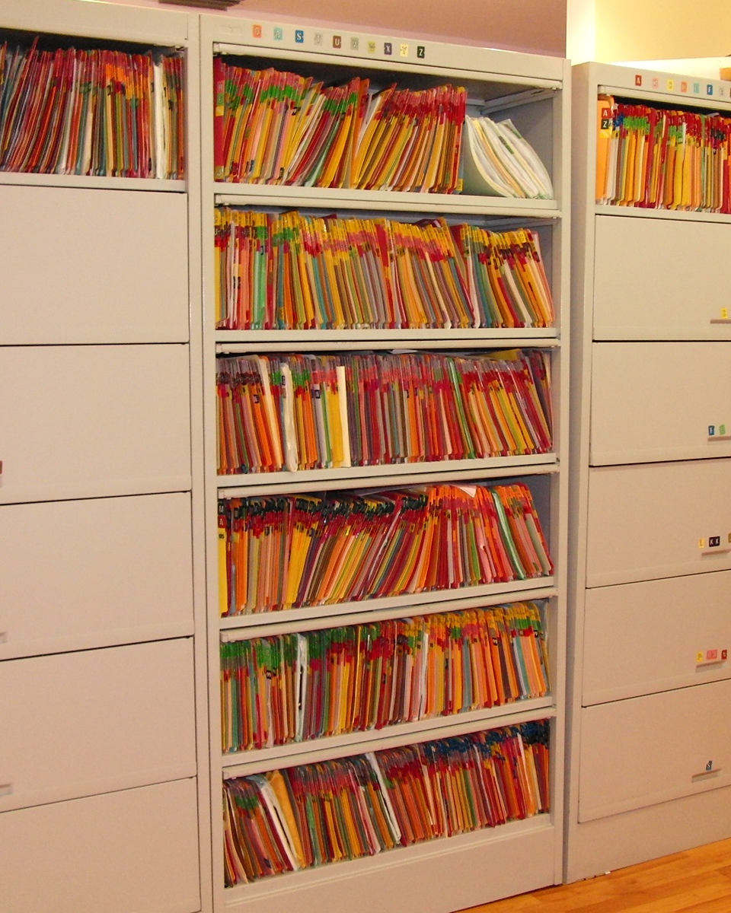
Managing Records
This Photo by Unknown author is licensed under CC BY.

Slide 12
Maintaining Records
Departments are responsible for maintaining their records from creation, during the active stage, and through the full retention period until record are eligible for disposition.
Best Practice – Get organized, and keep your files clean!
Maintain your Record Copies in a designated place (electronic or hard copy)
Dispose of Convenience Copies of records as soon as they have fulfilled their purpose – no need to wait the full retention period
Mark your files with the Agency Identification Number and date records are eligible for disposition before it is time to dispose of them

Slide 13
Electronic Storage of Records
Can we scan in paper copies to create electronic records? YES!
Records must be reviewed to make sure all data is preserved and legible
Records must be labeled and organized in a systematic way
Confidential and controlled (sensitive) information must be protected
Imaged records must be accessible for as long as the records are retained
Must be willing to keep the software to access or regularly update files as common formats change

Slide 14
Electronic Storage of Records
Imaging past records – things to consider:
How long do the records need to be maintained?
Does your department have the time or financial resources to devote to the project?
Include retention data in your labels
Record Classification
Disposition Information
Record Identifiers
Good Candidates
Bad Candidates
Very short or very long retention periods
Records rarely accessed
Papers in poor condition
Mid-range retention periods
Newly created records
Records often accessed (by department, or TPIA requests)

Slide 15
UTD Records Retention Schedule
Agency Item No. | Record Series Item No. | Record Series Title | Description | Ret. Code | Retention Period |  |  | AC Definition | Arch. | Remarks | Legal Citations
 |  |  |  |  | Y | M | D
ADR1037 | 1.1.053 | Registration Logs | Logs or similar records used to register persons appearing before state agencies as required by Chapter 2004, Government Code, including quarterly reports filed with the Texas Ethics Commission. | AC |  |  |  | AC = Report filed with the Texas Ethics Commission
ADR1038 | 1.1.055 | Strategic Plans | Information resources and operational strategic plans prepared in accordance with §2054.095, and §2056.002, Government Code. | AC | 6 |  |  | AC = September 1 of odd-numbered calendar years. | I | ARCHIVES NOTE: The archival requirement is met by sending required copies of the plans to the University Archives and to the Texas State Publications Depository Program, Texas State Library and Archives Commission.
ADR1039 | 1.1.056 | ADA Documentation | Self evaluations and plans documenting compliance with the requirements of the Americans With Disabilities Act. |  | 3 |  |  |  |  |  | 28 CFR 35.105c.

Slide 16
Disposing of Records
Identify
Find the correct series on the UTDRRS
https://legal.utdallas.edu/records-management/records-retention-schedule/
Verify
Confirm the retention period has passed for the records (using UTDRRS)
Are there any pending audits, Public Information Act requests, or litigation?
Approve
Complete the Request for Records Disposal form and submit to OLA
WAIT until the request is approved before disposing of records
Do any of the records require Archivist review? (look at UTDRRS or if you suspect historical value)
Dispose
Dispose of ALL versions of records (hard copy, electronic, convenience copy)
Think about all the places your office stores records (Box, shared drive, email, Teams, etc.)
Place hard copies in a shred bin (for sensitive information) or recycle bin
Report
Let OLA know the date you disposed of the records and how
Document the disposal on departmental Disposition Log

Slide 17
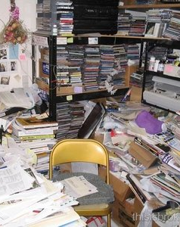
What is the harm in keeping records indefinitely?
Information Security – the more data we have, the more exposure in case of a data breach. Hackers can't get data we no longer have.
Open records requests - more time spent locating and producing records we would not otherwise be obligated to release.
Increased data retrieval time - the more records you must search through, the longer it takes to find what you actually need.
Records maintenance is easier in smaller quantities
Increased storage costs – storage of records, both hard copy and electronic, costs money
This Photo by Unknown author is licensed under CC BY-NC-ND.

Slide 18
Tools
OLA Records Management website – www.utdallas.edu/legal/records-management
UTD Retention Schedule
Records Disposal Request form
Faculty Cheat Sheet
Answers to basic questions
Join our distribution list
Shredding bins are managed by Facilities Management – shredding@utdallas.edu

Slide 19
Contact us: Legal.utdallas.edu/records-management recordsmanagement@utdallas.edu
Questions?

